Slide 1
Sinhgad College of Engineering Department of Information Technology
Project Title : “ Sentiment Analysis and Opinion Mining Using Natural Language Processing and Machine Learning”
Domain : Machine Learning
Ghorpade Pratik Vinod
Gaykhe Sonali Laxman
Gosavi Sachin Anil
Gade Shantanu Dattatraya
Guide
“Mrs. K.S.KORABU”

Slide 2
Aim & Objective
Aim : To analyze reviews of different products on various e-commerce sites and give polarity as positive or negative.
Objective:
To use Natural Language Processing (NLP) to tokenize, for POS tagging, Stemming, Dependency parsing and analyzing the sentiment.
To build supervised machine learning model using linear classifiers such as Support Vector Machine(SVM), Neural Network(NN) and K-Nearest Neighbor(KNN).
To use probabilistic algorithm as Naïve Bayes (NB), Maximum Entropy
Using Tools: Rapid Miner , NLTK, WEKA, Tensor Flow, H2o.

Slide 3
Introduction
Natural Language Processing : It is the application of computational techniques to the analysis and synthesis of natural language and speech.
Sentiment Analysis And Opinion Mining :
It is the process of computationally identifying and categorizing opinions expressed in a piece of text, especially in order to determine whether the writer's attitude towards a particular topic, product, etc. is positive, negative, or neutral.

Slide 4
Introduction
Basically Our Application focuses on the E-commerce websites.
It is very time consuming to visit all the website and there are thousands of reviews on each website .
graph or pie chart which will give the idea about product .
In addition User will be able to see the specifications of the products .
User will have the privilege to compare the products.

Slide 5
Literature Survey
Shiliang Sun , Chen Luo, Junyu Chen,” A review of natural language processing techniques for opinion mining systems“ [1].Describes review of natural language processing techniques for opinion mining systems, investigate the approaches of opinion mining for different levels and situations.Introduce comparative opinion mining and deep learning approaches for opinion mining
Dhanalakshmi V., Dhivya Bino, Faculty, Saravanan A. M” Opinion mining from student feedback data using supervised learning algorithms ” [2]describes opinion mining using supervised learning algorithms to find the polarity of the student feedback, paper also presents a comparative performance study of the algorithms like SVM, Naïve Bayes, K Nearest Neighbor and Neural Network classifier.
Vijay B. Raut, D.D. Londhe “Opinion Mining and Summarization of Hotel Reviews ” [3]decribes machine learning and SentiWordNet based method for opinion mining.
Setra Genyang Wicana, Taha Yasin İbisoglu , Uraz Yavanoglu “A Review on Sarcasm Detection from Machine-Learning Perspective ” [4]explains current mostly used method to detect sarcasm.

Slide 6
Motivation
The Consumers’ Perspective :
Need of a system that diﬀerentiates between good reviews and bad reviews.
Easy Comparison between products.
For Quick Decision Making.
Everything at one place .
The Producers’ Perspective :
Identify Issues and strengths of product.
Need of a system that can identify trends in customer reviews .
Improve product or service and also identify the requirements for the future.

Slide 7
Architectural Diagram
System Flow
E-Commerce Data(Reviews)
Preprocessing
(Tokenization ,Stop Words Removal , Stemming)
Price Prediction
Transformation
(Numerical Vector)
Classification
(Positive/Negative)
Feature Selection

Slide 8
Methodology
We have used Tenserflow tool to mine the customer review and classify it as positive and negative. The following methodology was adopted :
Step1: Extract The reviews using API’s.
Step2: Preprocess the Review Data.
Step3: Extract Entities and Features to find their individual polarity.
Step4: Train the model using SVM algorithm to classify into Positive and Negative classes.
Step5: Test the model to determine accuracy.
Step6: Repeat steps 4 and 5 using K-NN, NB and NN algorithms
Step7: Compare the results of the performance for the four algorithms.
Step 8: Generate Summary or Pie Chart using best algorithm.

Slide 9
UML
Class Diagram
Use Case
Sequence Diagram
State Diagram
Activity Diagram

Slide 10
Data Extraction
Pickle Formation
Reviews
Tokenization
Pickles
words
Stop word Removal
Autocorrection
words
Positive / Negative
/
Mixed
Positive / Negative
/
Mixed
Flag=0
No
NewWord Addition
WordNet
Flag=1
Classify
yes

Slide 11
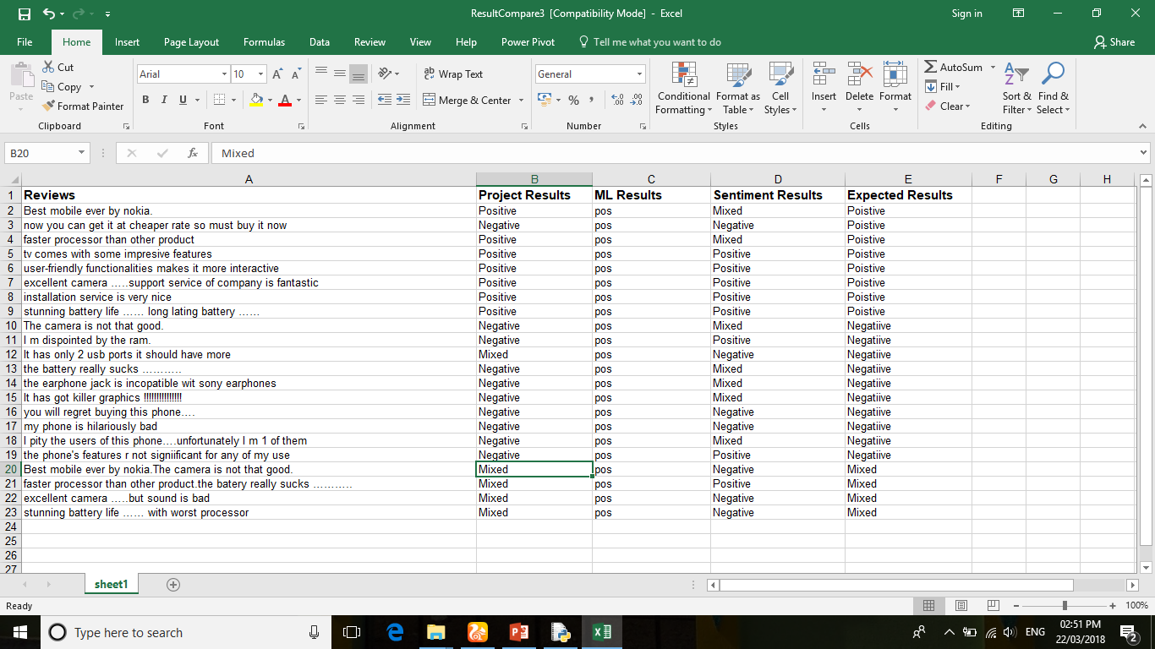
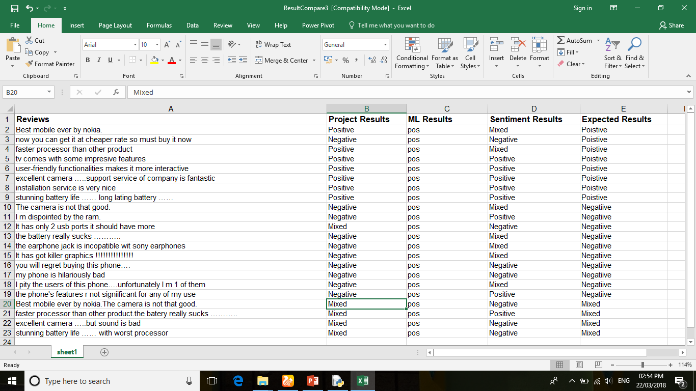
Test Results

Slide 12
Future Scope
Price Prediction
Sarcasm Detection
Generalization for other applications.

Slide 13
Conclusion
The project basically deals with Sentiment Analysis using Natural Language Processing and Price Prediction using Machine Learning algorithm. Data extraction is done by using Beautiful Soup Library provided by python . Featured based analysis is also achieved by using NLP .
All the processed data is stored in MySQL database . Computation can be done on different machines to reduce the execution time and increase efficiency . Website also provides comparative analysis between different products which leads to easy decision making .

Slide 14
References
Shiliang Sun , Chen Luo, Junyu Chen,” A review of natural language processing techniques for opinion mining systems“ [1]. Department of Computer Science and Technology, East China Normal University, 500 Dongchuan Road, Shanghai, 200241, PR China .
Dhanalakshmi V., Dhivya Bino, Faculty, Saravanan A. M” Opinion mining from student feedback data using supervised learning algorithms ”[2]. 2016 3rd MEC International Conference on Big Data and Smart City
Vijay B. Raut, D.D. Londhe “Opinion Mining and Summarization of Hotel Reviews ” [3],2014 Sixth International Conference on Computational Intelligence and Communication Networks
Setra Genyang Wicana, Taha Yasin İbisoglu , Uraz Yavanoglu “A Review on Sarcasm Detection from Machine-Learning Perspective ”[4], 2017 IEEE 11th International Conference on Semantic Computing.

Slide 15
Thank You...

